Slide 1

Anomaly Detection in ICSs using SNN
Student: Michael Kaminer

Slide 2
Main Sections:
1. Title and Authors.
2. Abstract.
3. Introduction.
4. Literature Review
a. Background
b. Related Work
5. Methodology.
6. Results.
7. Discussion.
8. Conclusion.
9. References.

Slide 3
Title and Authors
Anomaly Detection in ICSs using SNN
Student: Michael Kaminer
Supervisors: Prof. Shlomo Greenberg, Dr. Aviad Elyashar

Slide 4
Abstract
This research project investigates the potential of Spiking Neural Networks (SNNs) for anomaly detection in Industrial Control Systems (ICSs). The study compares the performance of SNNs with conventional machine learning and deep learning algorithms using several benchmark datasets: SWAT, WADI, BATADAL, and EPIC. Additionally, datasets such as ECG5000, TON_IoT, MNIST and TENEESSEE were utilized for pretraining and experimentation purposes. Various models were trained and evaluated across these datasets to assess their suitability for detecting anomalies in critical infrastructure environments. Our findings indicate that while SNNs are generally difficult to train and optimize, they yield promising results when used in combination with other methods rather than in isolation. This suggests that hybrid approaches involving SNNs may provide enhanced detection capabilities in complex ICS scenarios.

Slide 5
Introduction
Industrial Control Systems (ICSs) are increasingly targeted by cyberattacks due to their critical role in infrastructure. Anomaly detection is essential for securing these systems. This project explores the use of Spiking Neural Networks (SNNs) for anomaly detection in ICS environments. The main objective is to evaluate whether SNNs can outperform or complement traditional algorithms. Several ICS-related datasets (SWAT, WADI, BATADAL, EPIC) and auxiliary ones (ECG5000, TON_IoT, Tennessee) were used. We also investigated the SNN Torch framework and its applicability. The research aims to understand the strengths and limitations of SNNs in this domain.

Slide 6
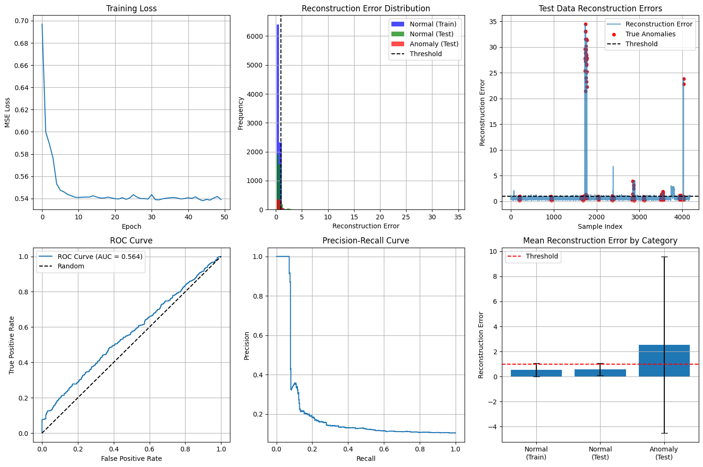

Slide 7
Literature Review. Background
Anomaly detection in ICSs involves identifying unexpected patterns that may indicate system faults or cyberattacks. Traditional approaches often rely on statistical methods, machine learning, or deep learning. Spiking Neural Networks (SNNs) are a neuromorphic computing model inspired by biological neurons, capable of processing temporal data efficiently. While promising, SNNs are harder to train due to their non-differentiable nature and sparse event-based computation. The project uses the SNN Torch framework to explore the applicability of SNNs in real-world ICS scenarios.

Slide 8
Literature Review. Related Work
Previous studies have applied machine learning and deep learning methods—such as Random Forests, SVMs, CNNs, and LSTMs—for anomaly detection in ICSs. These approaches have shown good accuracy but often require large labeled datasets and can be sensitive to noise. Recent research explores the use of SNNs in time-series classification and anomaly detection, but their application to ICS environments remains limited. Most existing works do not focus on combining SNNs with other models. This project aims to fill that gap by evaluating hybrid approaches that integrate SNNs with conventional algorithms.

Slide 9
Methodology
We trained and evaluated various anomaly detection models on multiple datasets. The main ICS datasets included SWAT, WADI, BATADAL, and EPIC. Additional datasets (ECG5000, TON_IoT, Tennessee, MNIST) were used for pretraining and testing generalization. Models included traditional algorithms (ML,DL) and SNNs implemented using the SNN Torch framework. Due to training complexity, SNNs were tested both independently and as part of hybrid models. Performance was compared across models using standard metrics such as accuracy and precision.

Slide 10
Results
SNNs showed mixed performance when used alone, often struggling with training convergence. However, when combined with traditional algorithms in hybrid models, the results improved significantly. On datasets like SWAT and WADI, hybrid approaches achieved higher accuracy and better anomaly detection rates. SNNs contributed to capturing temporal patterns that were missed by other models. These results suggest that SNNs are most effective when integrated into broader detection systems rather than used in isolation.

Slide 11
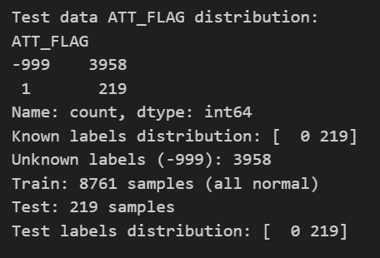
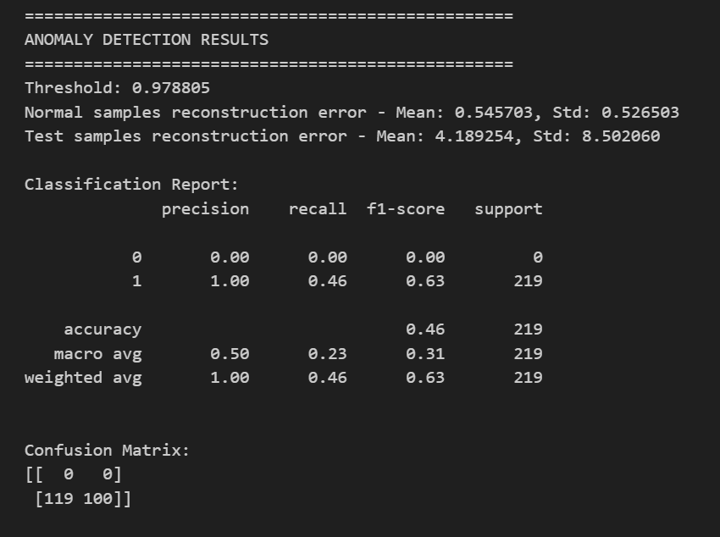

Slide 12
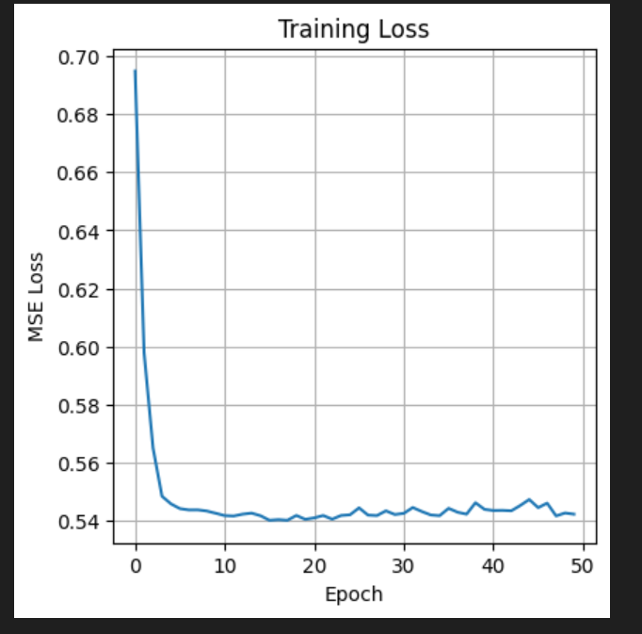
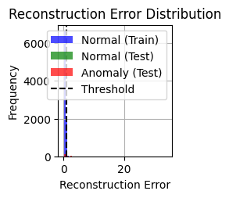
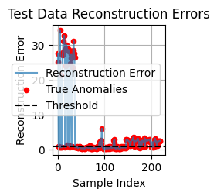
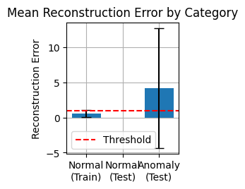

Slide 13
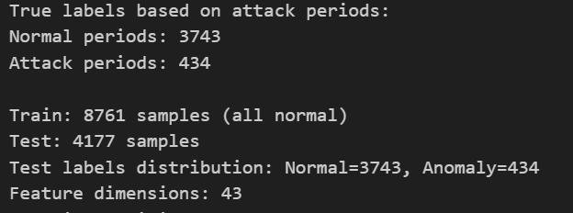
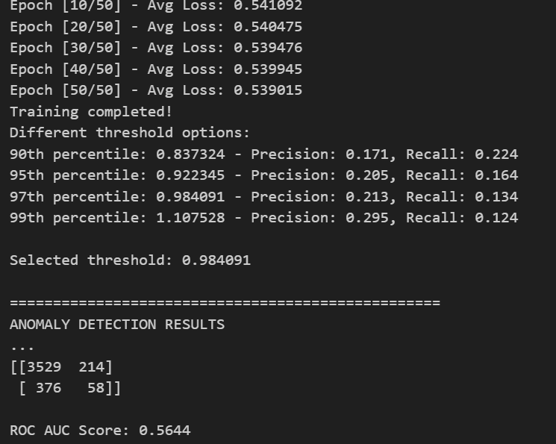

Slide 14
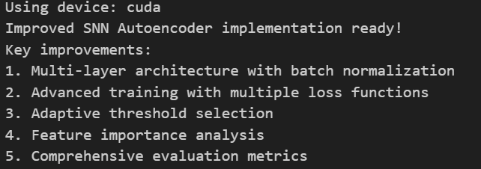
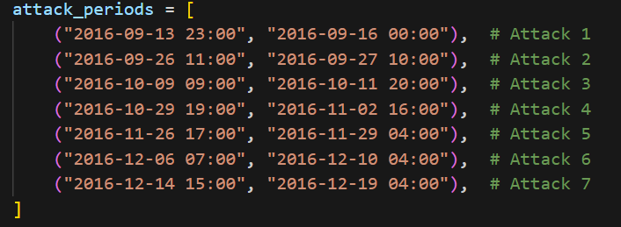
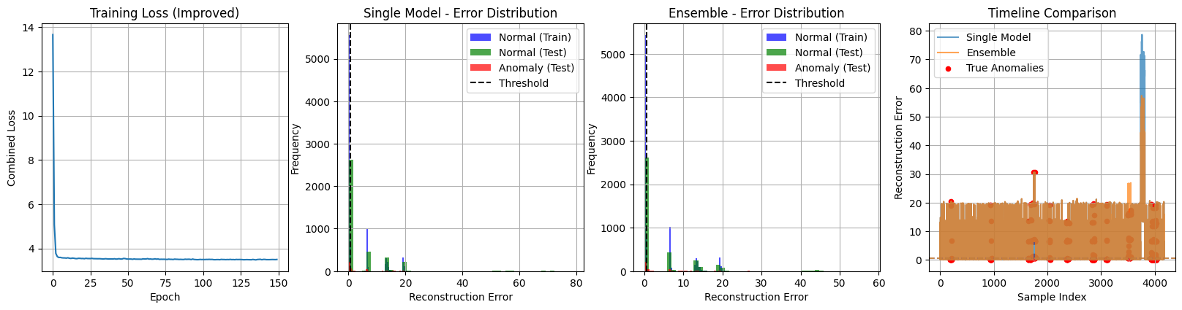

Slide 15
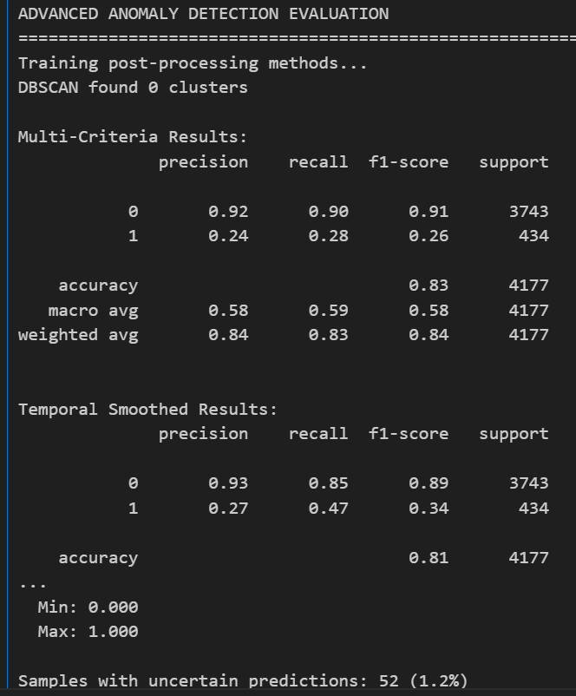

Slide 16
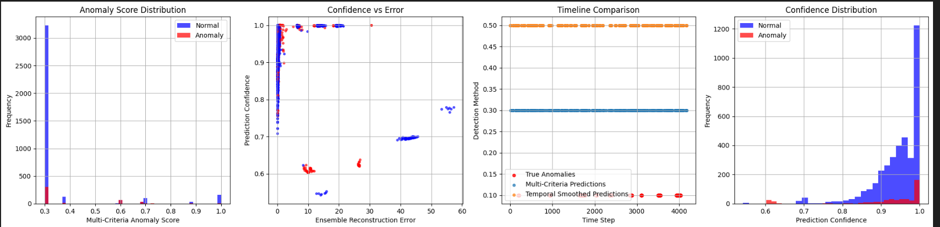

Slide 18
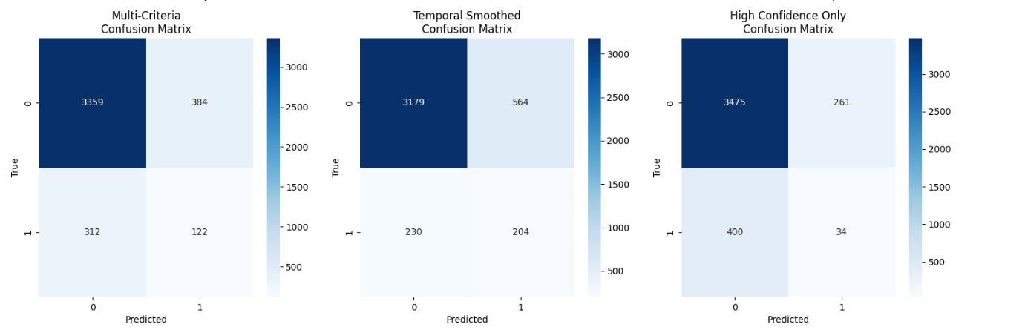

Slide 19
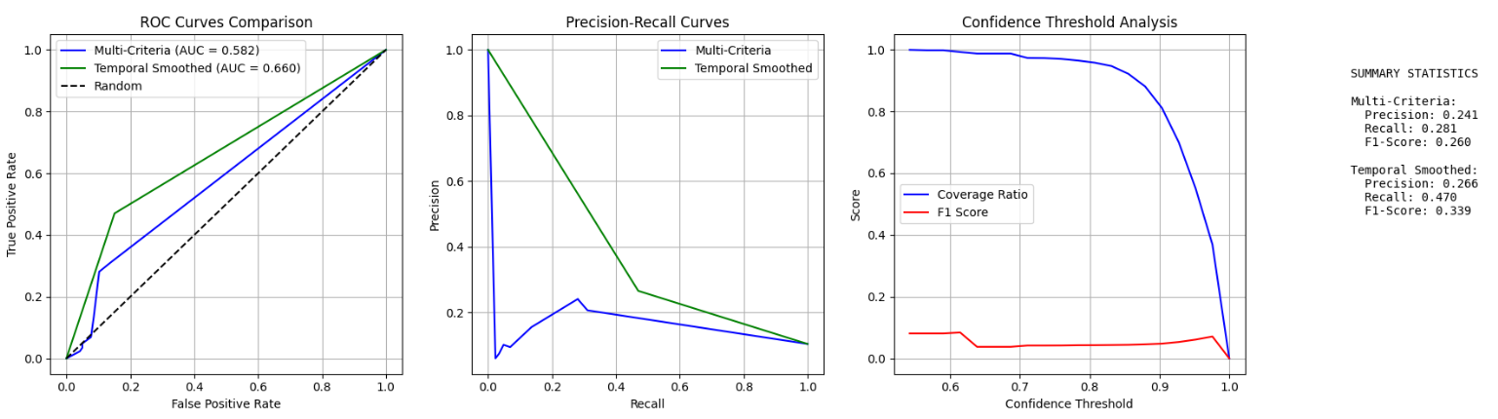

Slide 21
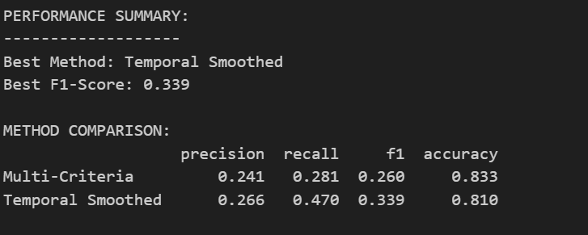

Slide 22
Discussion
The results highlight that while SNNs are challenging to train, they provide unique advantages in capturing temporal dynamics. Pure SNN models underperformed compared to traditional methods, but hybrid models combining SNNs with other algorithms performed better overall. This suggests that SNNs are not a replacement but a valuable addition to existing techniques. Their event-based nature may also offer benefits in low-power or real-time ICS applications.

Slide 23
Conclusion
This research explored the use of Spiking Neural Networks (SNNs) for anomaly detection in Industrial Control Systems. While standalone SNNs faced training difficulties, they proved useful when combined with traditional models. Hybrid approaches showed improved detection performance, especially on real-world ICS datasets. The findings support further exploration of SNNs as part of ensemble or multi-stage detection systems in critical infrastructure security.

Slide 24
References
[1] K. Stouffer, S. Lightman, V. Pillitteri, M. Abrams, and A. Hahn, Guide to Industrial Control Systems (ICS) Security: Supervisory Control and Data Acquisition (SCADA) Systems, Distributed Control Systems (DCS), and Other Control System Configurations such as Programmable Logic Controllers (PLC), NIST Special Publication 800-82, Rev. 2 (Initial Public Draft), National Institute of Standards and Technology, 2014.
[2] Y. Hu, A. Yang, H. Li, Y. Sun, and L. Sun, “A survey of intrusion detection on industrial control systems,” International Journal of Cyber Security and Digital Forensics, first published online Aug. 17, 2018.
[3] W. Knowles, D. Prince, D. Hutchison, J. F. P. Disso, and K. Jones, “A survey of cyber security management in industrial control systems,” Computers & Security, Mar. 2015.
[4] A. M. Y. Koay, R. K. L. Ko, H. Hettema, and K. Radke, “Machine learning in industrial control system (ICS) security: Current landscape, opportunities and challenges,”. May, 2022. p.380(p.4 pdf)
[5] Chandola, V., Banerjee, A., and Kumar, V. 2009. Anomaly detection: A survey. ACM Comput. Surv. 41, 3, Article 15 (July 2009), 58 pages. DOI=10.1145/1541880.1541882 http://doi.acm.org/10.1145/1541880.1541882
[6] Guansong Pang, Chunhua Shen, Longbing Cao, and Anton van den Hengel. 2021. Deep Learning for Anomaly Detection: A Review. ACM Comput. Surv. 54, 2, Article 38 (March 2021), 38 pages. https://doi.org/10.1145/3439950
[7] Antiy Security Response. (2016, March 16). Comprehensive Analysis Report on Ukraine Power System Attacks.
[8] https://www.ncsc.gov.bh/en/cyberwiser/ics.html
[9] https://www.trendmicro.com/en_us/research/22/c/an-in-depth-look-at-ics-vulnerabilities-part-1.html
[10] J. D. Nunes, M. Carvalho, D. Carneiro, and J. S. Cardoso, “Spiking neural networks: A survey,” IEEE Access, vol. 10, Jun. 2022, doi: 10.1109/ACCESS.2022.3179968.
[11] F. Ponulak and A. Kasiński, “Introduction to spiking neural networks: Information processing, learning and applications,” Acta Neurobiologiae Experimentalis, vol. 71, pp. 409–433, 2011.
[12] J. Vreeken, Spiking Neural Networks: An Introduction, 2003.
[13] SWAT: A Spiking Neural Network Training Algorithm for Classification Problems John J. Wade, Liam J. McDaid, Jose A. Santos, and Heather M. Sayers
[14] https://snntorch.readthedocs.io/

